Slide 1


Module 3. Lesson 2.
The Smart Notes application
Link to guidelines

Slide 2

Module 3. Lesson 2. The Smart Notes application. P. 1
Discussion:
The Smart Notes application

Slide 3


Let's get back to the request!
The theoretical research institute has turned to us with a request for a Smart Notes application.
The scientists should be able to:
Create and delete notes.
Edit notes.
Add tags to notes.
Search the notes using tags.
Ready to get started?
Discussing
work tasks
Cole,
senior developer

Slide 4

Last time we resolved two important issues
How do we organize the storage of these notes?
We need to program long-term storage of information! For example, we can use text files.
How do we program the appearance of the program?
Of course, using PyQT!
Discussing
work tasks

Slide 5
How do we read notes from a file and use them in a program?
Discussion:
Smart Notes

Slide 6
How do we read notes from a file and use them in a program?
I
II
III
A note is an instance of the Note class
A note is a dictionary with the keys “name,” “tags,” and “text”
Unknown option
Discussion:
Smart Notes
A set of notes is a list of “Note” objects
A set of notes is a list of dictionaries with notes
Possible options for presenting a set of notes

Slide 7
If it is arranged as a
single note:
List of tags
Name
A very smart note
Discussion:
Smart Notes
Text of the note

Slide 8
Then the arrangement of a file with notes:
Note_1
Tag_1
Tag_2
Note text
Note_2
Tag_2
Tag_3
Tag_4
Note text
Note_1
[Tag_1, Tag_2]
Note text
Discussion:
Smart Notes
Note_2
[Tag_2, Tag_3, Tag_4]
Note text
Possible arrangement for a file with notes.

Slide 9
Then the arrangement of a file with notes:
And the number of tags may be different.
Any note can be deleted by the user.
Tags for a specific note can also be added and deleted.
Note_1
Тag_1
Тag_2
Note text
Note_2
Тag_2
Тag_3
Тag_4
Note text
Discussion:
Smart Notes
Possible arrangement for a file with notes.

Slide 10
The file data should also be displayed in application widgets:
Note_1
Тag_1
Тag_2
Note text
Note_2
Тag_2
Тag_3
Тag_4
Note text
Note text
Note_1
Note_2
...
Discussion:
Smart Notes
Control elements
Тag_1
Тag_2
Тag_3
Тag_4
The structure is quite complicated to work with!

Slide 11
Professional developer recommendations:
Optimize your productivity by using special files with predefined data structures!
III
Unknown option —
Json files
Discussion:
Smart Notes

Slide 12
The goal of the work day is
to program the application interface and arrange the storage of notes in a json file.
Today you will:
Discussing
work tasks
Learn how a json file works — a file with a predefined data structure.
Program the application interface.
Upload your first smart note.

Slide 13

Module 3. Lesson 2. The Smart Notes application. P. 1
Qualifications

Slide 14

Demonstrate your knowledge
of the PyQt library and working
with text files
Qualifications

Slide 15
Where and how can I arrange long-term
data storage?
Qualifications

Slide 16
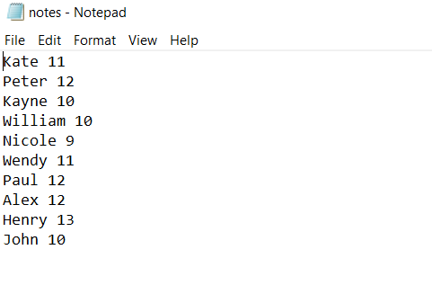
For example, in a text file:
Qualifications

Slide 17
Which access attributes
do you know for a file with data?
Qualifications

Slide 18
File access attributes:
Purpose of the function | Function in Python
Open file for reading | open(“notes.txt”, “r”)
Open file for writing | open(“notes.txt”, “w”)
Open file for appending | open(“notes.txt”, “a”)
Qualifications

Slide 19
What construction
will open a notes.txt file
for reading data?
Qualifications

Slide 20
The construction
will open a notes.txt file
for reading data:
Purpose of the function | Function in Python
Open file for reading | with open(“notes.txt”, “r”) as file:
Reading file data | data = file.read()
Close file when finished | The file will automatically close after the end of the with operator block
Qualifications

Slide 21
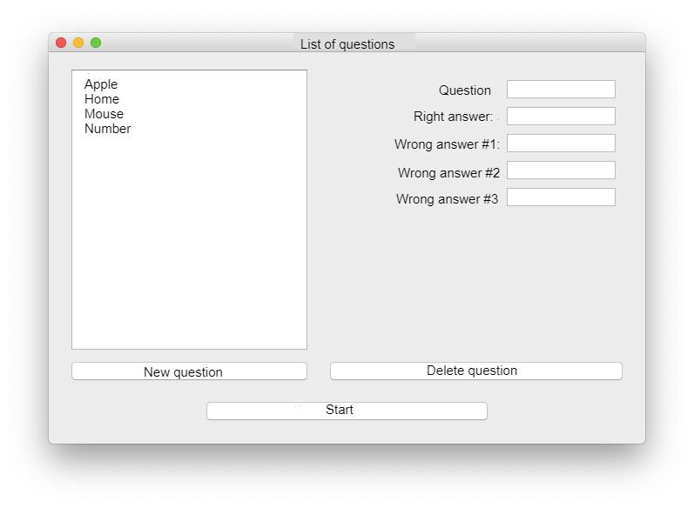
How do we create an application window in PyQT?
What widgets for this window do you know?
?
Qualifications
?
?

Slide 22
How do we create an application window in PyQT?
What widgets for this window do you know?
QWidget()
Qualifications
QLabel
QPushButton

Slide 23
What is a layout? What does it consist of?
Qualifications

Slide 24
What is a layout? What does it consist of?
A layout is an interface element with which widgets can be arranged along lines.
Qualifications

Slide 25
Name and show the guide lines in this window:
There may be several options!
Qualifications

Slide 26
Possible answer:
There may be several options!
Qualifications

Slide 27
Which command creates these lines?
Qualifications
?
?

Slide 28
Which command creates these lines?
Qualifications
QVBoxLayout( )
QHBoxLayout( )

Slide 29
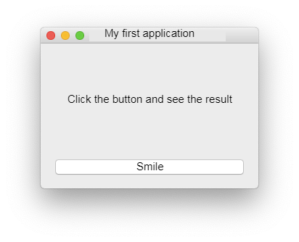
How do we arrange the widgets and run the application?
#which layouts do we create?
#how do we display the application?
to_read
Qualifications
to_press

Slide 30
How do we arrange the widgets and run the application?
#which layouts do we create?
col = QVBoxLayout()
col.addWidget(to_read)
col.addWidget(to_press)
main_win.setLayout(col)
#how do we display the application?
main_win.show()
app.exec_()
to_read
Qualifications
to_press

Slide 31
Qualifications confirmed!
Great, you are ready to brainstorm and work on your tasks!
Qualifications

Slide 32
Module 3. Lesson 2. The Smart Notes application. P. 1
Discussion:
Smart Notes
Interface

Slide 33


Smart Notes should have the following:
Name request
Enter
text
Set tags
Enter tag to search
Result: list of notes
Creating notes
Searching notes
Smart Notes
Discussion:
Smart Notes
Information on notes
List of note tags
When running the application
When clicking on the name of the note
List of available notes
Note text

Slide 34
What widgets do we need for this?
Enter note name
Enter tag to search
Note text
Enter note text
?
?
Smart Notes
Discussion:
Smart Notes
List of available notes
List of note tags
Control elements for all actions
?
?
Result: list of notes

Slide 35
What widgets do we need for this?
Name request
Enter tag to search
Note text
Enter text
QLineEdit
QTextEdit
Smart Notes
Discussion:
Smart Notes
List of available notes
List of note tags
Control elements for all actions
QListWidget
QPushButton
Result: list of notes

Slide 36
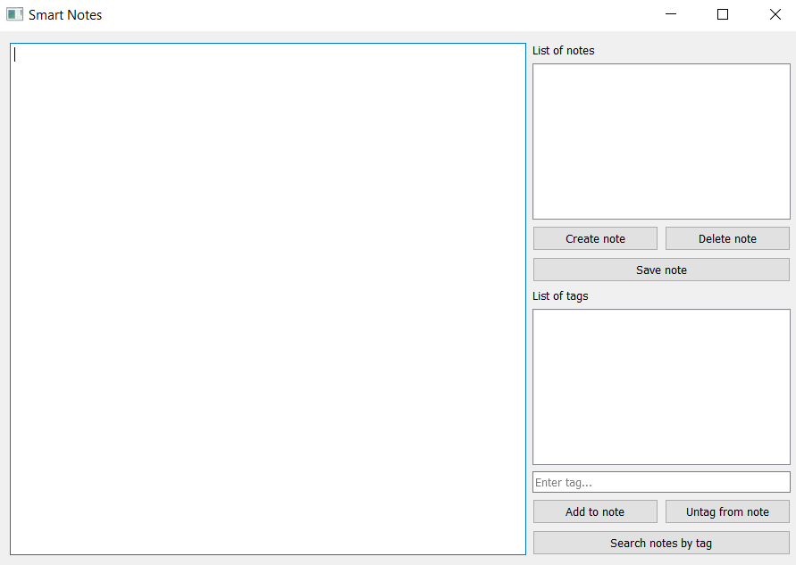
Possible interface for Smart Notes
Note list
Enter note text
Tag list
Discussion:
Smart Notes
Add tag
Search by tag

Slide 37
Possible interface for Smart Notes
QListWidget
QTextEdit
QListWidget
Discussion:
Smart Notes
Add tag
Search by tag

Slide 38
Useful methods QTextEdit
Method | Purpose
field_text = QTextEdit() | Constructor for creating a QTextEdit field for entering text
field_text.setText(Text) | Set the text in parentheses in the field
Discussion:
Smart Notes

Slide 39
Useful methods QListWidget
Method | Purpose
list_tags = QListWidget() | Constructor for creating a QListWidget field for a list
list_tags.addItems(Title_1) | Adding items to a list
list_tags.clear() | Clearing QListWidget lists
list_notes.itemClicked | Is one of the items in the QListWidget list selected?
list_notes.itemClicked.connect(...) | *Using the method in event processing
Discussion:
Smart Notes

Slide 40
Tasks:
Create the Smart Notes application interface.
If you have any problems, use the tips.
Discussion:
Smart Notes

Slide 41

Module 3. Lesson 2. The Smart Notes application. P. 1
Visual Studio Code:
The Smart Notes application

Slide 42




Complete the tasks in VS Code
VSC. Smart Notes application
VS Code
Working
in VS Code

Slide 43
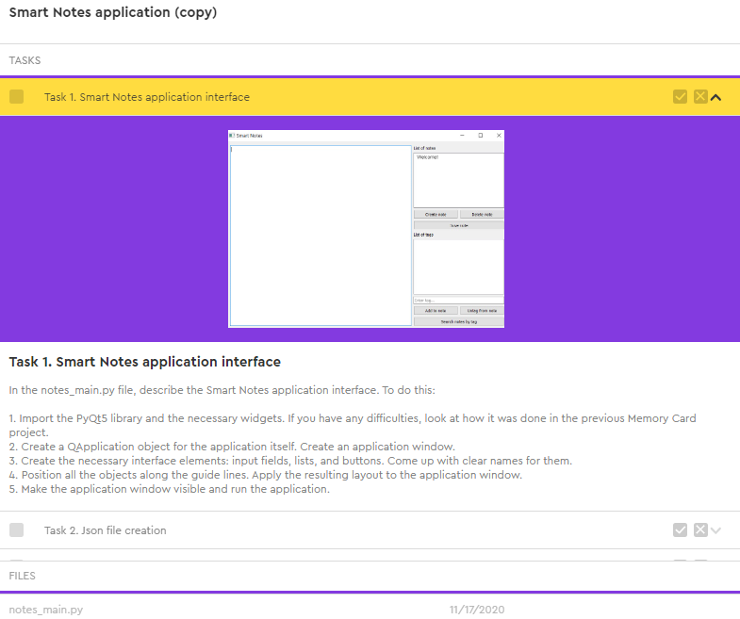
Complete the tasks in VS Code
VSC. Smart Notes application
Complete the task
Task 1.
Smart Notes application interface.
Working
on the platform

Slide 44

Module 3. Lesson 2. The Smart Notes application
Break

Slide 45
Module 3. Lesson 2. The Smart Notes application
Review:
Data Structures

Slide 46
What is a dictionary?
Review

Slide 47

A dictionary is an unordered set of “key : value” pairs
notes = {
"About the sun" : "The sun is a star!",
"About the earth" : "The earth is a planet!"
}
Review

Slide 48
How do we get the value of a dictionary element using a key?
notes = {
"About the sun" : "The sun is a star!",
"About the earth" : "The earth is a planet!"
}
Review

Slide 49
Getting the value of a dictionary element using a key:
value = notes["About the sun"]
print(value)
>>>The sun is a star!
Review

Slide 50
Match the features with the structures:
The elements are ordered
Elements are accessed using an index
The elements are key-value pairs
The in operator checks for elements
Review
New elements are added using append()
The elements are not ordered
LISTS
DICTIONARIES

Slide 51
Match the features with the structures:
LISTS
DICTIONARIES
The elements are ordered
The elements are not ordered
New elements are added using append()
Review
The elements are key-value pairs
Elements are accessed using an index
The in operator checks for elements
The in operator checks for elements

Slide 52
Yay! Now our application will definitely be the smartest!
Review
👨‍🎓

Slide 53

Module 3. Lesson 2. The Smart Notes application. P. 1
New topic:
Storing data in
json files

Slide 54

Problem:
We need a structure for easy storing data about notes.
(Notes can have transitions to new lines! How do we write them to a file and read from there?)
This structure should be easy to use when working with PyQt.
Brainstorming

Slide 55
Possible structure:
notes = {
"Note name" :
{
"text" : "Very important note text",
"tags" : ["draft", "thoughts"]
}
}
Brainstorming

Slide 56
Possible structure:
notes = {
"Note name" :
{
"text" : "Very important note text",
"tags" : ["draft", "thoughts"]
}
}
Note name
Brainstorming
Fields for one note
print(notes[“Note name”][“text”])
>>>Very important note text

Slide 57
Potential problem:
This structure is convenient. But it may be hard to read and write to the file.
Brainstorming
It would be nice if the structure in the file and the structure in the program looked the same.
Then reading and writing information to the file would be very simple.

Slide 58
Potential problem:
This structure is convenient. But it may be hard to read and write to the file.
Solution:
Brainstorming
It turns out that this structure is used by programmers around the world.
Let’s look at a ready-made solution.

Slide 59
A json file
is a file with a ready-made structure that’s easy to read and use.
Brainstorming
The structure of a json file is very similar to the system of nested dictionaries and lists
in Python.

Slide 60
Json file:
Dictionary
Key_1 :
Key_2 :
Key_Х : Data
Key_Х : Data
Brainstorming
Key_Y : Data
Key_Y : Data
Key_Z : Data
Key_Z : Data
. . .

Slide 61
Json file with notes:
notes
“About planets” :
“About black holes” :
“text” : “What if water on Mars is a sign of life?”
“text” : “There is no singularity on the event horizon”
Brainstorming
“tags” : [“Mars”,
“hypotheses”]
“tags” : [“black holes”,
“facts”]
. . .

Slide 62
Json file with notes:
{
"About planets" :
{
"text" : "What if water on Mars is a sign of life?",
"tags" : ["Mars", "hypotheses"]
},
"About black holes" :
{
"text" : "There is no singularity on the event horizon",
"tags" : ["black holes", "facts"]
}
}
Brainstorming

Slide 63
Reading json files:
Command | Purpose
import json | Connecting the json library
with open("f.json", "r") as file: | Open the json file for reading
data = json.load(file) | Upload the structure from the json file to the data dictionary
Brainstorming
After reading it, data has the same structure as the json file!

Slide 64
Writing in json files:
Command | Purpose
import json | Connecting the json library
with open("f.json", "w") as file: | Open the json file for writing
json.dump(data, file) | Upload the structure from data to the json file
Brainstorming
The json file is being completely overwritten!

Slide 65
Useful writing parameters:
Command | Purpose
encoding="utf-8" | Set a universal text encoding (can be useful for writing data)
sort_keys=True | Sort master keys (note titles) when writing
Brainstorming
Example:
json.dump(data, file, sort_keys=True)
Load the dictionary data in file...
...after sorting the keys alphabetically...

Slide 66
Creating json files:
Ways to create
json files:
Manually
In the program
Brainstorming
In the project folder, create an empty file with the .json extension
When you write any note (for example, with instructions for the application), a file will be created automatically
If a file with the same name has not existed before.

Slide 67
Let's move on to Smart Notes:
In the notes_main.py file, create a notes dictionary with notes.
In notes, create one “Welcome” note with instructions for working in Smart Notes.
Let's write this note to the notes_data.json file (the file will be created automatically).
Brainstorming

Slide 68
The notes dictionary:
notes
“Welcome” :
“text” : “In this application
you can create
notes with tags...”
Brainstorming
“tags” : [“smart notes”,
“instructions”]
. . .

Slide 69
Writing notes to a json file:
Open a json file
to write data
:
Write the notes dictionary to the file (if necessary, specify parameters)
Brainstorming
Outcome.
The notes_data.json file has been created, which contains the starting note. The structure for notes is now set.

Slide 70
What does the program do with the notes_data.json file data after starting the application?
Brainstorming

Slide 71
Run the application:
Opening a json file for reading and loading data into the notes structure.
Displaying note titles in a QListWidget.
list_notes
Brainstorming
list_notes.addItems(notes)

Slide 72
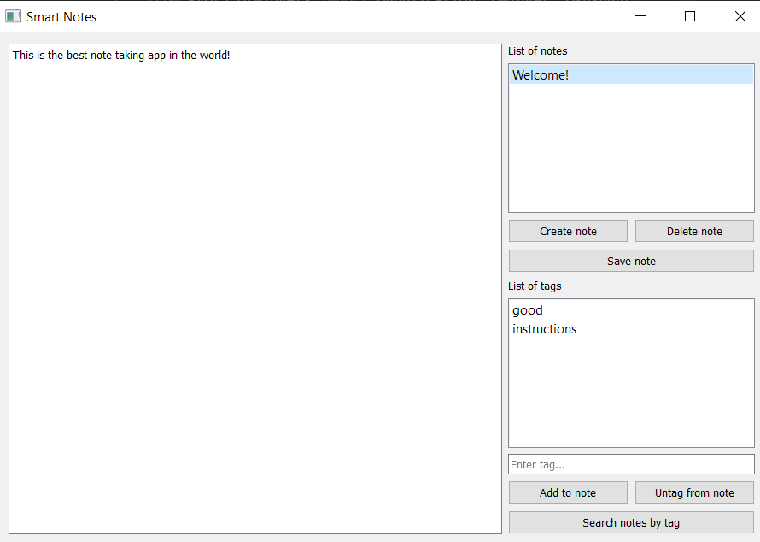
What does the program do when you click on a note’s title?
Brainstorming

Slide 73
Title click handling:
The list of note tags and the text should be displayed.
Calling the processor function show_note( )
Brainstorming
field_text
list_tags

Slide 74
Title click handling:
def show_note():
We get the title of the selected note
as a string.
We set the text of the note with the found title in field_text (QTextEdit).
Brainstorming
We clear the list of tags (if there was something there) and add the tags of the note with the found title there.

Slide 75
Title click handling:
def show_note():
name = list_notes.selectedItems()[0].text()
field_text.setText(notes[name]["text"])
list_tags.clear()
list_tags.addItems(notes[name]["tags"])
Brainstorming

Slide 76
Tasks:
Create a note with instructions and write it to a json file, thereby creating it.
When starting the application, read the information from the json file and place it in the widgets.
Process clicking on the note title in the list.
Brainstorming

Slide 77
Module 3. Lesson 2. The Smart Notes application. P. 1
Visual Studio Code:
The Smart Notes application

Slide 78
Complete the tasks in VS Code
VSC. Smart Notes application
VS Code
Working
in VS Code

Slide 79
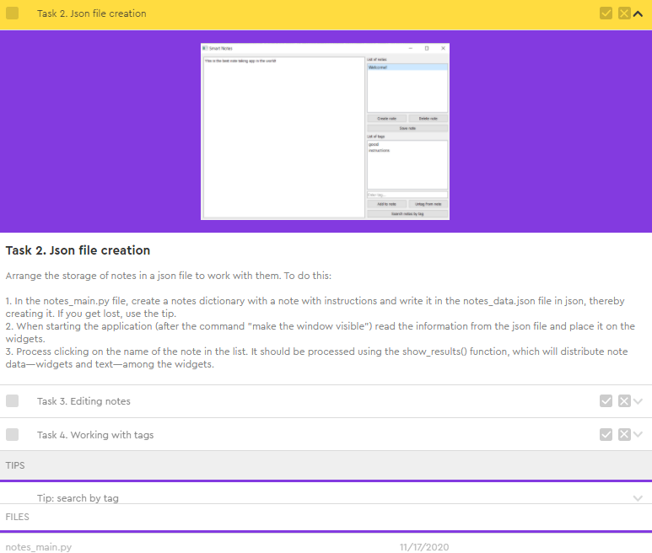
Complete the tasks in VS Code
VSC. Smart Notes application
Complete the task
Task 2.
Creating a json file.
Working
on the platform

Slide 80

Module 3. Lesson 2. The Smart Notes application. P. 1
Wrapping up
the work day

Slide 81


Let’s end up the work day by answering these technical questions:
What is a json file? What are their advantages over regular text files?
How do we read json files and write data to them?
What is the best operator to use for opening and closing files?
How do we read a file line by line?
Wrapping up
the work day
Cole,
senior developer
Emily,
project manager

Slide 82

Excellent work!
Colleagues,
Today you programmed the interface of the Smart Notes application and arranged the storage of notes in a json file.
Outside working hours, be sure to add explanatory comments to the code and look at the theoretical documentation
Wrapping up
the work day

